Slide 1
Winter Winning Camp
DATABASE MANAGEMENT SYSTEM
Department Of Career Planning & Development

Slide 2
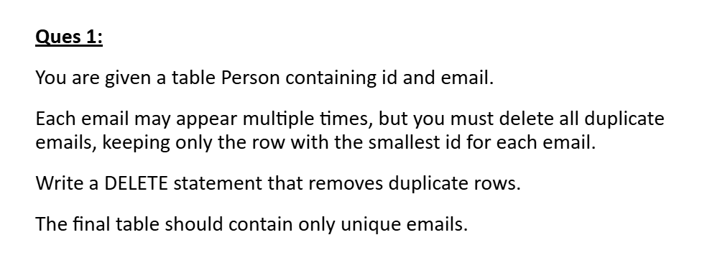
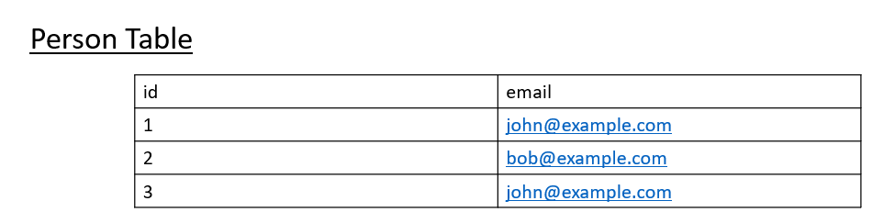
Delete Duplicate Emails

Slide 3
Output:
id | email
1 | john@example.com
2 | bob@example.com

Slide 4
Average Time of Process per Machine
Ques 2: You are given an Activity table that records when each process on each machine starts and ends.
Each process has exactly one start and one end entry, and start always occurs before end.
Your task is to calculate the average processing time for each machine.
A process's processing time = end.timestamp – start.timestamp.
Return one row per machine with machine_id, processing_time (rounded to 3 decimal places)

Slide 5
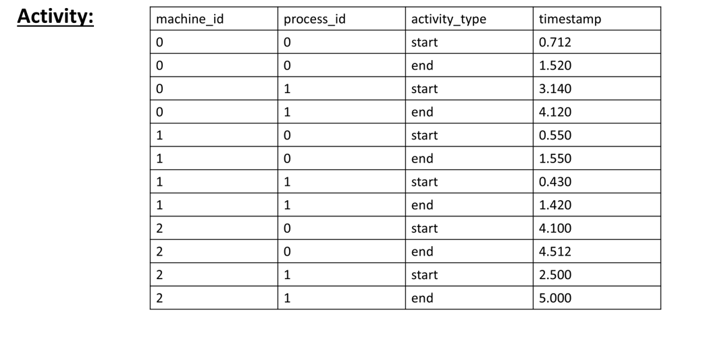

Slide 6
Output:
machine_id | processing_time
0 | 0.894
1 | 0.995
2 | 1.456

